Slide 1
Mystery_Solver: A Bayesian Network-Based Mystery Solver Application
By Group 8 CSE440 (Section-1)

Slide 2
Group Members
Serial No. | Student Name | Student ID
1 | Sadia Islam Mou | 2131724642
2 | Naima Zaman Roshni | 2212628042
3 | Hridy Chowdhury | 2014159642
4 | Tarif Shahriar | 1821113042

Slide 3
Introduction & Motivation
Problem
In real investigations, clues are often incomplete, uncertain, or conflicting.
Traditional reasoning struggles to combine such evidence into clear conclusions.
Solution: Mystery_Solver
Uses Bayesian Networks to connect suspects and evidence.
Each new clue updates the probabilities of guilt.
Provides an interactive interface to visualize how evidence changes belief.

Slide 4
Background: Bayesian Networks
What are Bayesian Networks?
Probabilistic graphical models: nodes = variables, edges = dependencies
Encode cause–effect relationships in a Directed Acyclic Graph (DAG)
Use Conditional Probability Tables (CPTs) to quantify relationships
Allow belief updating when new evidence is observed

Slide 5
Background: Bayesian Networks
Why Bayesian Networks?
Clues in a mystery are often uncertain or incomplete
BNs can combine many clues together
Each new clue updates suspect probabilities
Shows who is most likely guilty in a clear way

Slide 6
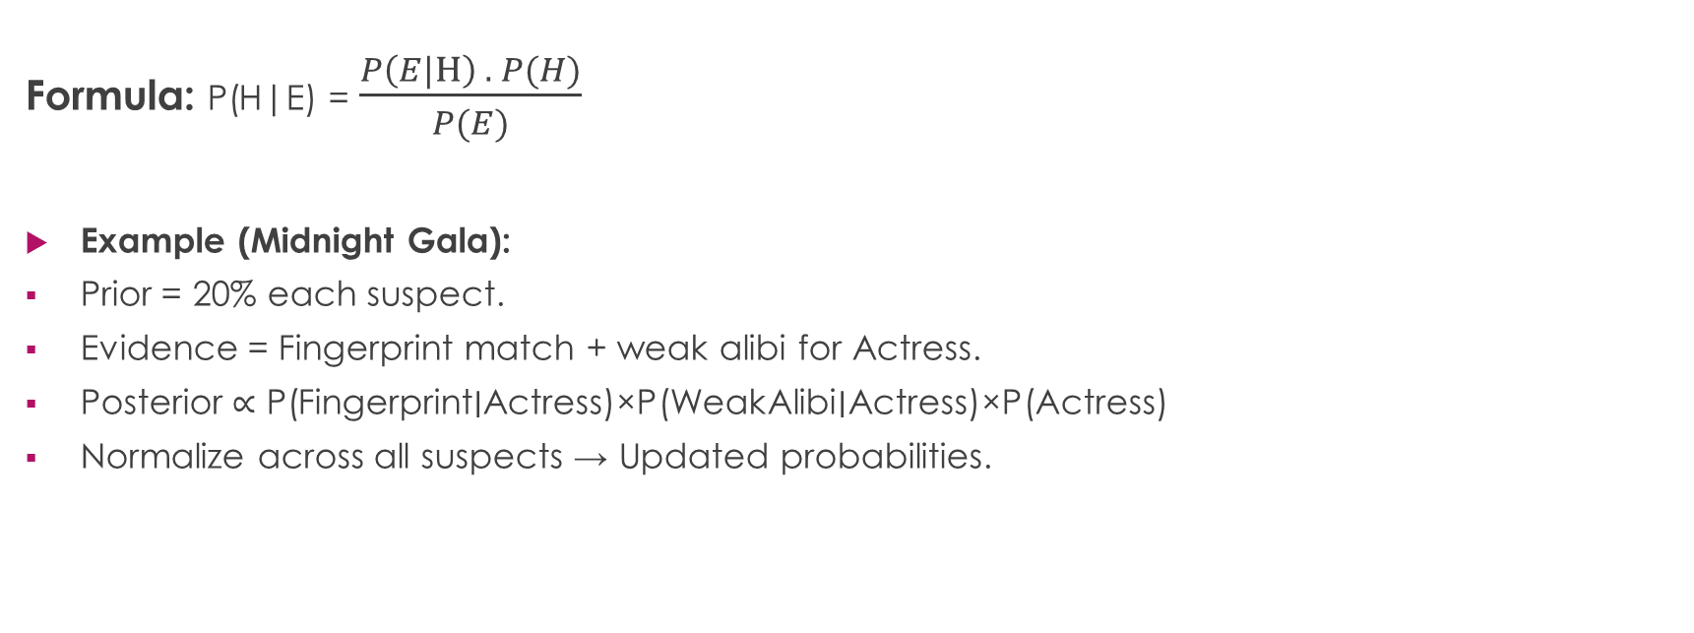
Bayes’ Theorem in Action
Formula: P(H|E) = $\frac{P\left(E|H\right) . P(H)}{P(E)}$
Example (Midnight Gala):
Prior = 20% each suspect.
Evidence = Fingerprint match + weak alibi for Actress.
Posterior ∝ P(Fingerprint∣Actress)×P(WeakAlibi∣Actress)×P(Actress)
Normalize across all suspects → Updated probabilities.

Slide 7
How we use them in Mystery_Solver
Root Node: GuiltyParty (which suspect is guilty)
Evidence Nodes: Alibis, Fingerprints, Motive, Witness, Security Footage, etc.
Inference: When a clue is added, the BN updates the posterior probabilities for each suspect
Implemented with pgmpy for inference + Streamlit for interactive visualization

Slide 8
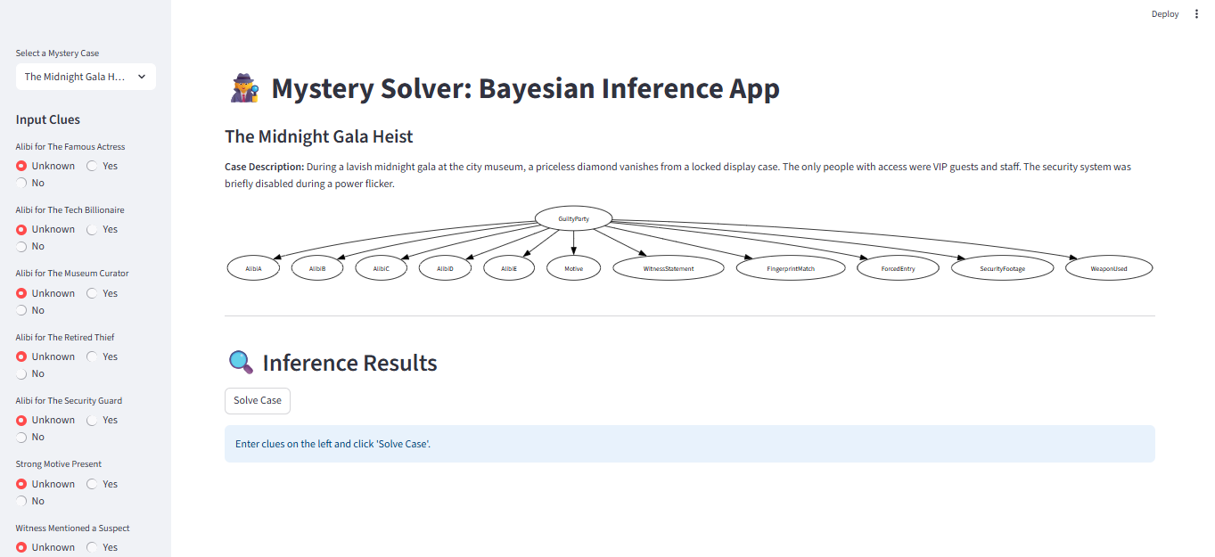
Bayesian Network Model

Slide 9
Scenario 1(The Midnight Gala Heist)
Evidence Collected
Alibi A: No, Alibi B: Yes, Alibi C: No, Alibi D: Yes, Alibi E: No
Witness Statement: Yes
Fingerprint Match: D
Security Footage: No
Weapon Used: Hacking Device
Inference Result
Highest probability: The Famous Actress – 60.91%
Others: Curator 15.23%, Retired Thief 10.75%, Guard 8.93%, Billionaire 4.18%
Explanation
Actress seen near display, weak alibi → most likely culprit.
Posterior belief updated with witness + fingerprint evidence

Slide 10
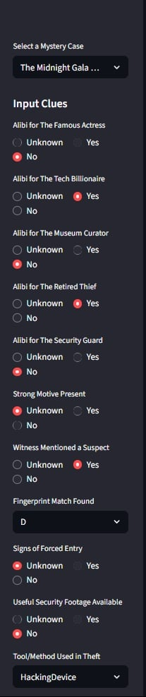
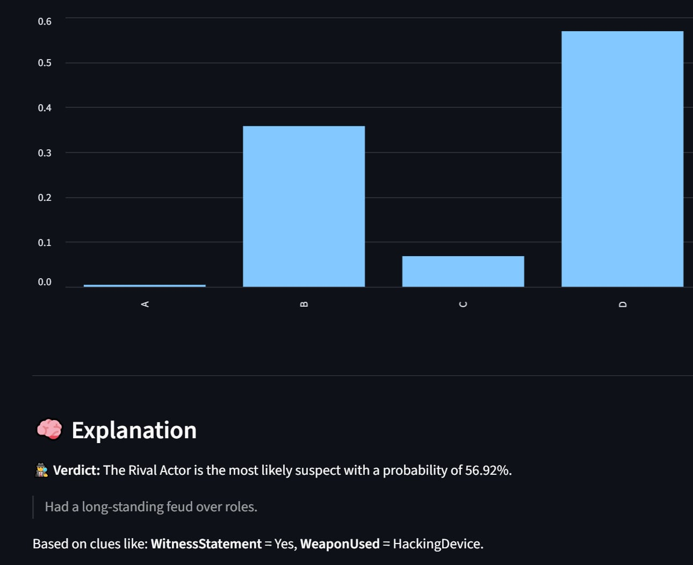
Scenario 1(The Midnight Gala Heist)

Slide 11
Scenario 2(The Poisoned Stage)
Evidence Entered
Alibi A: Yes, Alibi B: No, Alibi C: Yes, Alibi D: No, Alibi E: Yes
Witness Statement: Yes
Fingerprint Match: C
Forced Entry: Yes
Security Footage: Yes
Weapon Used: Hacking Device
Inference Result
Highest probability: The Rival Actor – 56.92%
Others: Stage Manager 35.78%, Ex-Spouse 6.82%, Understudy 0.43%, Catering Assistant 0.06%
Explanation
Rival Actor had feud history, no alibi, and was seen near stage.
Evidence converges → most probable suspect.

Slide 12
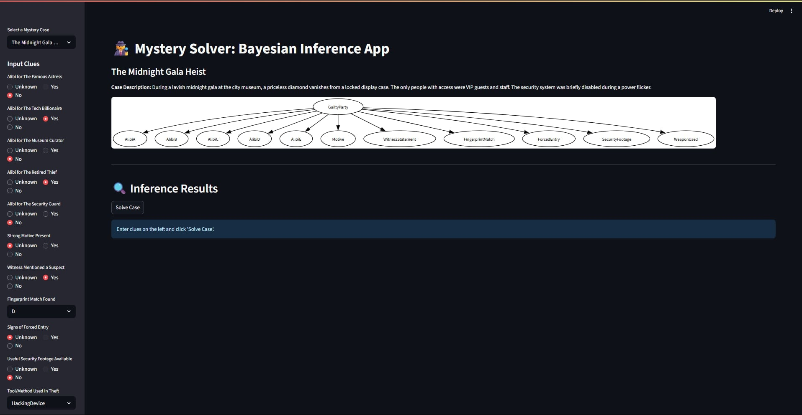
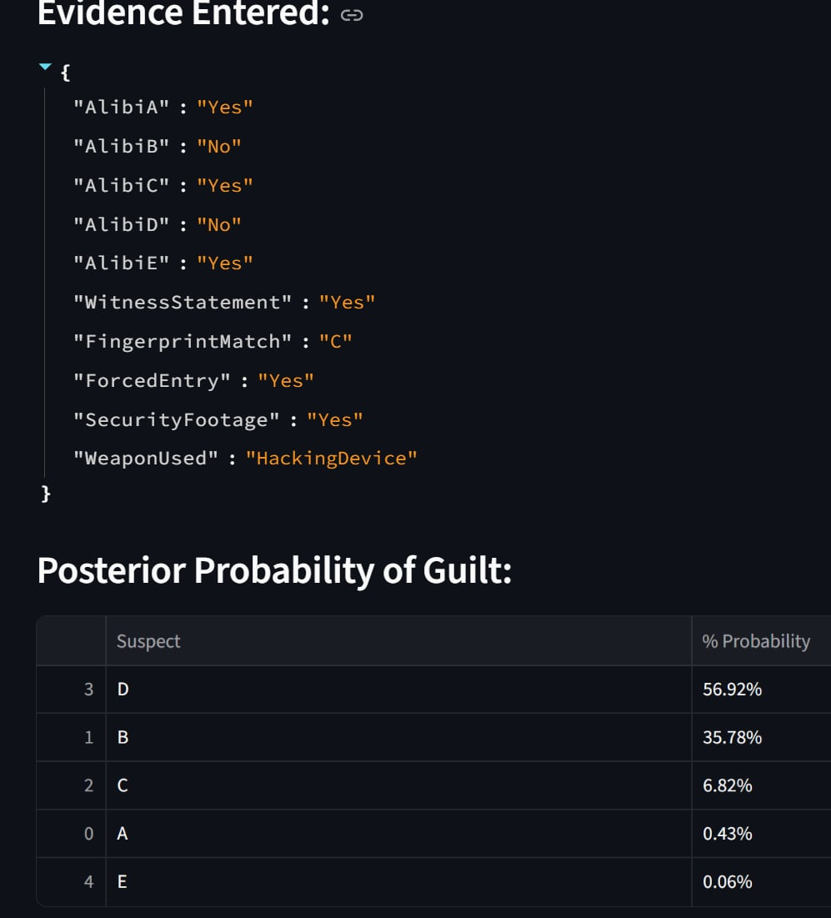
Scenario 2(The Poisoned Stage)

Slide 13
System Architecture & Implementation
Architecture
UI Layer (Streamlit – main.py)
Case selection, evidence input, result visualization
Scenario Loader (scenario_loader.py)
Reads JSON cases → suspects & evidence schema
Bayesian Engine (mystery_solver.py)
Builds BN, defines CPDs, runs inference (Variable Elimination)
Explainer (explainer.py)
Converts probabilities into verdicts & explanations

Slide 14
System Architecture & Implementation
Implementation Details
Nodes: GuiltyParty (root), Evidence nodes (Alibis, Fingerprints, Motive, Witness, etc.)
Edges: GuiltyParty → Evidence nodes (conditional independence assumption)
Inference: Variable Elimination (pgmpy)
Visualization: Graphviz DAG + matplotlib bar chart
Output: Posterior table + explanation in plain text

Slide 15
Discussion
Strengths
Shows how Bayesian Networks handle uncertain clues
Interactive UI makes probability updates clear
Easy to add new mystery cases via JSON
Educational tool for probabilistic reasoning
Interpretation
Results are conditional on model + evidence
Probabilities show likelihood, not absolute truth

Slide 16
Limitations
Relies on hand-crafted priors and CPDs
Assumes independence of evidence given suspect
Scalability: inference slows with many suspects/clues
Missing or weak evidence can reduce accuracy
No handling of time-sequence clues (e.g., events over time)
Some users may find probabilities hard to interpret

Slide 17
Future Work
Learn CPDs from real datasets instead of manual design
Add dynamic Bayesian networks for time-based reasoning
Improve visual explanations (graphs + natural language)
Handle missing or uncertain evidence more robustly

Slide 18
Conclusion
Built Mystery_Solver, an interactive BN-based app
Combines suspects, clues, and evidence into probabilities
Demonstrates Bayesian inference in practice
Bridges storytelling, probability, and AI education
A fun yet powerful way to explore reasoning under uncertainty

